Slide 1
Data-Oriented Models.
Based on the book by
David William Brown
John Wiley & Sons, ISBN 0471371378
‹#›

Slide 2
The need of a middle level notations
In the last example, when we analyzed a database, database tables are the final results we have
How can we be sure that the analysis is correct by watching these tables?
What is the logic of our analysis, if others try to understand our system? Final tables are very bad explanations.
Can we have some kind of notations that help to record our thoughts or encourage our rethinking of the design?
What is the essence behind the design logic?
‹#›

Slide 3
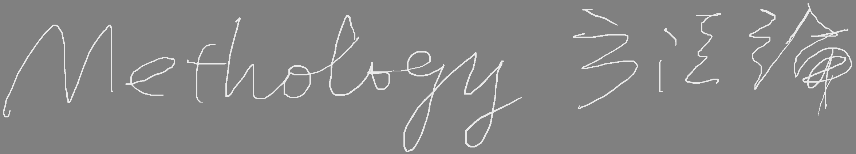
4.1. Data Models: The ERD
Mid-1970s: Databases were just coming into use
Research to find ways to model data
To give template for database design
Many notations were tried
Chen (1976) proposed the
Entity-Relationship Diagram (ERD)
‹#›

Slide 4
The ERD was the first systems analysis tool to focus on
DATA
and
How it is Linked and Organized.
It was from this that objects then evolved.
‹#›

Slide 5
4.1. Data Models: The ERD
Chen made two contributions:
The Entity-Relationship Principle, and
The Entity-Relationship Notation.
These further issues were also investigated by Chen and others:
E-R models for database design
The significance of the data of an enterprise
Data as a corporate asset.
The stability of the data of an enterprise
‹#›

Slide 6
❶ The Entity-Relationship Principle.
To manage a sales operation, we need to keep data about :
Sales
Customers
Products
Sales
Sales clerks
‹#›

Slide 7
❶ The Entity-Relationship Principle.
To run a phone company, we would need to keep data about:
Phone
Customers
Numbers
Lines
Calls
Services
‹#›

Slide 8
❶ The Entity-Relationship Principle.
To run a booking agency we must
record information about:
Booking
Venues
Artists
Agents
Concerts
Performances
Customers
Seats
‹#›

Slide 9
❶ The Entity-Relationship Principle.
To run a booking agency we must
record information about:
Booking
Venues
Artists
Agents
Concerts
Performances
Customers
Seats
Notice there is no Date in this list.
Why Not?
‹#›

Slide 10
❶ The Entity-Relationship Principle.
A date is data that describes a Concert
A date can describe many things
The key word here is
Things
‹#›

Slide 11
❶ The Entity-Relationship Principle.
Each of these lists is a list of things
Phone
Customers
Numbers
Lines
Calls
Services
Booking
Venues
Artists
Agents
Concerts
Performances
Customers
Seats
Sales
Customers
Products
Sales clerks
‹#›

Slide 12
❶ The Entity-Relationship Principle.
The E-R principle focuses on the things we need to keep data about.
Earlier methods emphasized what the users need to know to do their job.
Here we emphasize what things the users need to know about.
The word Entity means a thing.
Later we worry about what items they need to know about each entity.
‹#›

Slide 13
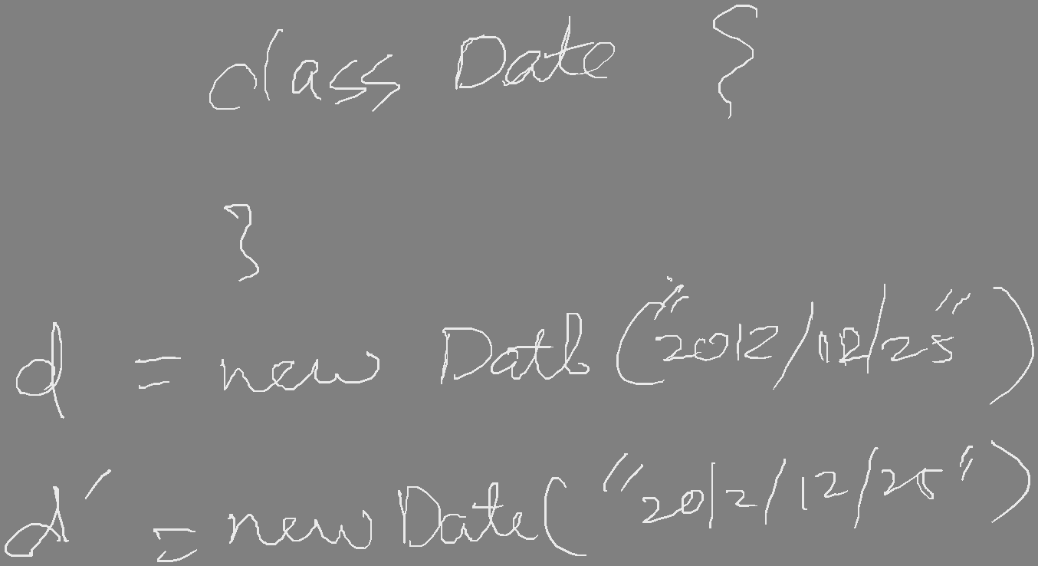
❶ The Entity-Relationship Principle.
Webster: An entity is “something that has separate and distinct existence”
You can see it is something we need to know about (i.e., keep data about) to do our job
So we define it. . .
‹#›

Slide 14
❶ The Entity-Relationship Principle.
A Data Entity is something that has separate and distinct existence in the world of the users and is of interest to the users in that they need to keep data about it in order to do their job.
‹#›

Slide 15
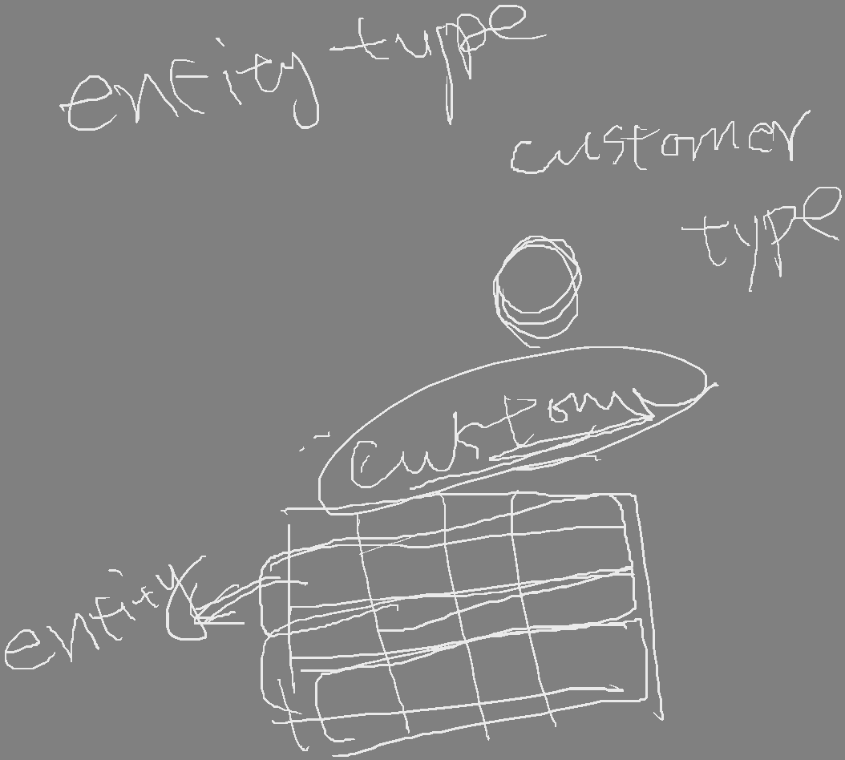
❶ The Entity-Relationship Principle.
So these are the entity lists for these businesses:
Booking
Venues
Artists
Agents
Concerts
Performances
Customers
Seats
Sales
Customers
Products
Sales clerks
Phone
Customers
Numbers
Lines
Calls
Services
‹#›

Slide 16
❶ The Entity-Relationship Principle.
Grammatically, the term Entity refers to a single specific Customer or Product or Sale or Call or Artist.
What we need to talk about mostly is the class of all Customers, or in other words the type of thing called a Customer.
‹#›

Slide 17
❶ The Entity-Relationship Principle.
So we define:
Entity Type
An is a class or category expressing the common properties that allow a number of entities to be treated similarly.
‹#›

Slide 18

❶ The Entity-Relationship Principle.
An individual Customer or Product or Sale or Call or Artist is then an Occurrence
of the Entity Type.
‹#›

Slide 19
Entity type
Entity
Occurrence
class
object
instance
‹#›

Slide 20
❶ The Entity-Relationship Principle.
I am an occurrence of the entity type “Employee”
You are an occurrence of the entity type “Student”
We each live in an occurrence of the entity type “Dwelling”
The last time you caught an occurrence of the entity type “Bus,” it followed an occurrence of the entity type “Route” while executing an occurrence of the entity type “Trip.”
‹#›

Slide 21
❶ The Entity-Relationship Principle.
Attributes are the data elements carried by an entity that describe it and record its state.
Attributes are the things we need to know about an Entity.
‹#›

Slide 22
❶ The Entity-Relationship Principle. Associations:
So we have:
Hundreds of Customers
Thousands of Products
Dozens of Sales Clerks
Do we have a business?
NOT YET!
‹#›

Slide 23
❶ The Entity-Relationship Principle. Associations:
Not until:
A Customer buys a Product
A Sales Clerk sells a Product
A Sales Clerk sells to a Customer
These are the interactions
that occur between entities.
Note each involves a verb.
‹#›

Slide 24
❶ The Entity-Relationship Principle. Associations:
We define:
An Association is the interaction of two entities and is represented by a verb.
‹#›

Slide 25
❶ The Entity-Relationship Principle. Associations :
The purpose is to provide access paths to the data.
When a sale occurs, we will link:
A Customer
To a Product
To a Sales Clerk.
Using a verb to describe each link.
‹#›

Slide 26
❷ E-R models for database design.
To start with, the search for data modeling methods was for database design.
Many notations were developed and some actually tried out.
Chen’s ERD turned out best and took over.
It also caught on as a tool for systems analysis, as well as for data analysis.
‹#›

Slide 27
❷ E-R models for database design.
For database design:
Each Entity Type becomes a file or table.
Each Attribute becomes a field (i.e., a column)
Each Association becomes an access pathway (i.e., a foreign key)
‹#›

Slide 28
A non-intersect history
In the early 70s’ Database field begins to understand the important of data. The idea of entity type (class) occurrence (objects) and attribute begins to emerge. And, more importantly the stability of data
In the meantime, software engineering enter the era of procedure-oriented, searching for reusable modules and procedures.
‹#›

Slide 29
❸ The Stability of Data.
This year, our favorite Transit Company is concerned with entity types:
Bus, Driver, Route, Trip, Bus Stop and Passenger.
Ten years from now, there will be many changes in how the company is run, and in how the people do their jobs.
But they will still have to deal with
Buses, Drivers, Routes, Trips, Bus Stops and Passengers!
Not only that, but ten years ago they worked with
Buses, Drivers, Routes, Trips, Bus Stops and Passengers!
‹#›

Slide 30
❸ The Stability of Data.
However, entities are neither static nor stagnant;
There may be an occasional new entity,
There will often be new attributes,
But as long as we stay in the
same business
there will be very
few new entities.
‹#›

Slide 31
❸ The Stability of Data.
This stability contributes greatly to reducing the costs and delays in system maintenance.
‹#›

Slide 32
❸ The Stability of Data.
However, beware new business!
Mergers, acquisitions, takeovers and diversifications can all put your company into
new businesses
with a host of
new entity types.
‹#›

Slide 33
❹ The Significance of Data.
The Data modeler’s Creed:
Data
is the
Centre of the Universe
‹#›

Slide 34
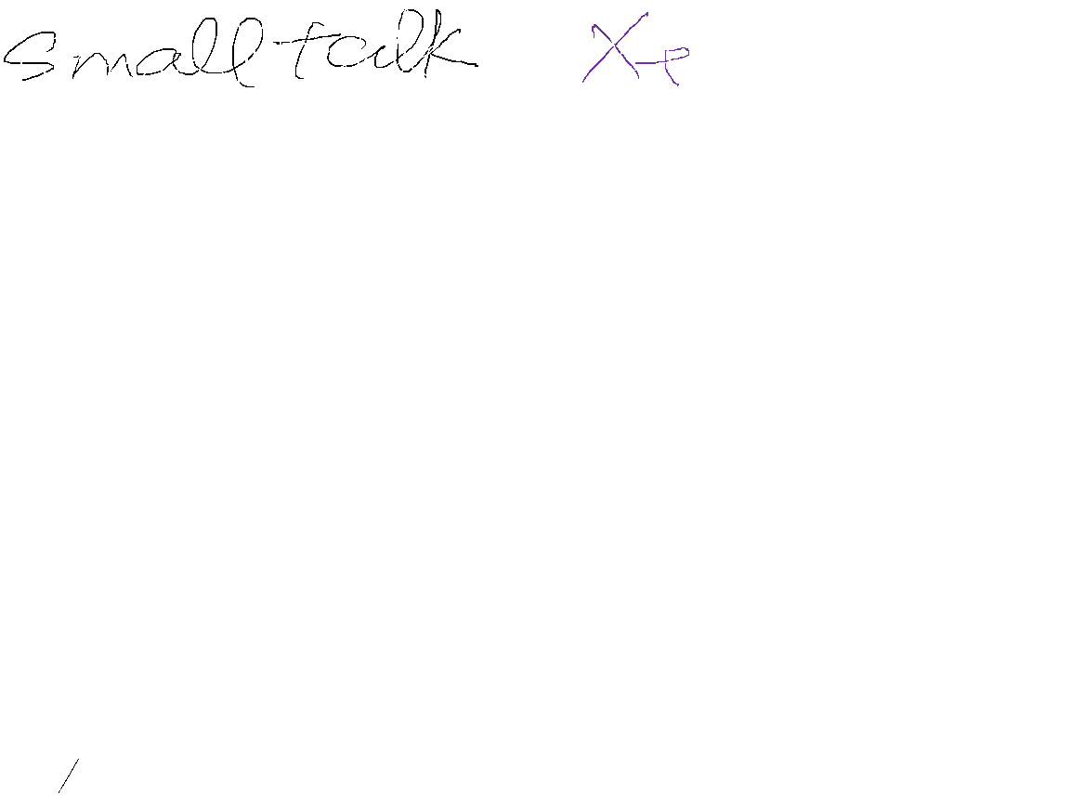
In the meantime
SE researchers search for reusable software unit based on procedure oriented had failed !!
Some bright people began to think the essence of software
They suddenly aware of that the data is seldom changed but procedures (system functions) are changed frequently
‹#›

Slide 35
❻ The Entity-Relationship Notation.
There are many E-R notations.
All of them work, any will do the job.
Use whichever one you or your boss or your professor or your client prefers.
UML is now the standard notation in the object world, so
We will use UML for our Entities as well as our Objects.
‹#›

Slide 36
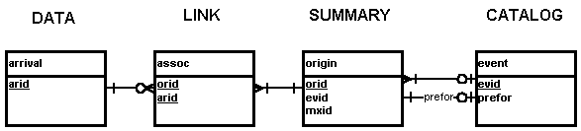
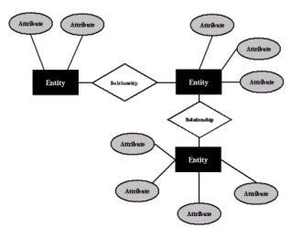
ERD diagrams notations
‹#›

Slide 37

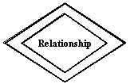


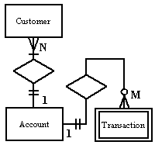



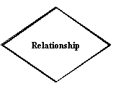
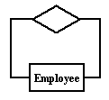
‹#›

Slide 38
UML era
Now, UML is the most popular notations for system analysis and design
So, we use UML to draw ERD
‹#›

Slide 39
❻ The Entity-Relationship Notation. Entities
Draw an Entity as a square or rectangular box, divided by a line near the top.
Above the line place the name, singular.
Student
‹#›

Slide 40
❻ The Entity-Relationship Notation. Attributes
If there are not too many, Attributes may go in the bottom part of the box.
Primary key first, marked with an asterisk.
If not enough room, show only the key,
list the others in the accompanying write-up.
Student
*Student No.
Name
Age
Sex
‹#›

Slide 41

❻ The Entity-Relationship Notation. Associations:
Draw a line joining two entity boxes to show a relationship exists
Write the verb above the line.
Enrolls In
Course
Offering
Student
*Student No.
Name
Age
Sex
*Course No.
*Date
Room No.
Max Enrol
‹#›

Slide 42
❻ The Entity-Relationship Notation. Associations
Add a solid arrowhead so that it makes a sentence when you read it in the direction of the arrow:
“Student enrols in course”
Enrolls In
Course
Offering
Student
*Student No.
Name
Age
Sex
*Course No.
*Date
Room No.
Max Enrol
‹#›

Slide 43

❻ The Entity-Relationship Notation. Associations
Instructor
*Employee No.
Name
Age
Sex
Salary
teaches
Course
Offering
Student
*Student No.
Name
Age
Sex
Enrolls In
*Course No.
*Date
Room No.
Max Enrol
‹#›

Slide 44
❻ The Entity-Relationship Notation. Associations
Instructor
College
*Employee No.
Name
Age
Sex
Salary
*Name
Address
Phone
Rating
Employs
teaches
Enrols In
Course
Offering
Student
*Student No.
Name
Age
Sex
*Course No.
*Date
Room No.
Max Enrol
‹#›

Slide 45

❻ The Entity-Relationship Notation. More Examples of Associations
Customer
Product
*A/c No.
Name
Address
Phone No.
Balance
*Prod No.
Description
Unit Price
Qty in Stock
buys
Read the sentence in the direction of the arrow:
“Customer buys Product.”
‹#›

Slide 46
❻ The Entity-Relationship Notation. More Examples of Associations
Customer
Product
*A/c No.
Name
Address
Phone No.
Balance
*Prod No.
Description
Unit Price
Qty in Stock
buys
“Customer buys Product”
Driver
Bus
*Employee No.
Name
Wage
Sex
drives
*Bus No.
Make
Model
Seating
“Driver drives Bus”
Read the sentence in the direction of the arrow.
‹#›

Slide 47
❻ The Entity-Relationship Notation. Multiplicity
Q. When a driver drives a bus, how many does she drive?
A. One, usually. But over time?
Why, a whole bunch!
Q. When a Customer buys a Product, how many does he buy?
A. One per transaction, perhaps, but over time we hope he’ll buy a great many.
‹#›

Slide 48
❻ The Entity-Relationship Notation. Multiplicity
The critical thing we need to know is
Is it One, or
Is it Many?
This is the Multiplicity of the relationship (also called cardinality).
‹#›

Slide 49
❻ The Entity-Relationship Notation. Multiplicity
Webster defines Cardinality as “The number of members in a set.”
For us, Multiplicity is the number of occurrences of each entity type that can be involved in an association.
‹#›

Slide 50

❻ The Entity-Relationship Notation. Multiplicity
We diagram this by adding a star (asterisk) below the relationship line whenever it should show “many.”
Read this one as
“Instructor teaches many course offerings”
Instructor
Course
Offering
*Employee No.
Name
Age
Sex
Salary
teaches
*Course No.
*Date
Room No.
Max Enrol
*
‹#›

Slide 51
❻ The Entity-Relationship Notation. Multiplicity
We refer to this as a
“One-to-Many” Association,
or 1:M
Instructor
Course
Offering
*Employee No.
Name
Age
Sex
Salary
teaches
*Course No.
*Date
Room No.
Max Enrol
*
‹#›

Slide 52
❻ The Entity-Relationship Notation. Multiplicity
Read the sentence in the direction of the arrow
Read the star (asterisk) as the word “many.”
Instructor
Course
Offering
*Employee No.
Name
Age
Sex
Salary
teaches
*Course No.
*Date
Room No.
Max Enrol
*
‹#›

Slide 53

❻ The Entity-Relationship Notation. Multiplicity
And, since we wish many Customers to buy many Products,
This one is a Many-to-Many association, or M:M
Customer
Product
*A/c No.
Name
Address
Phone No.
Balance
*Prod No.
Description
Unit Price
Qty in Stock
buys
*
*
‹#›

Slide 54
❻ The Entity-Relationship Notation. Multiplicity
There are numerous other symbols also used for the “many” end of a relationship,
including single and double arrows, etc.
The star (asterisk) is the UML standard.
Other ERD notations have their own ways to show “many” and what direction to read the sentence.
‹#›

Slide 55
❻ The Entity-Relationship Notation. Summary
Multiplicity is one (straight line) or many (asterisk) below each end of the line.
1:M
*
M:M
*
*
‹#›

Slide 56
Let’s try to draw the problem of supply part again
S#: 零件供應商的編號
SNAME: 零件供應商的姓名
CITY1 零件供應商的城市
P# 零件編號
PNAME 零件名稱
COLOR 零件色彩
WEIGHT 零件重量
CITY2 零件所儲存的城市
QTY 零件的存量
一個零件可能有多個供應商可以供應, 例如正新輪胎與南港輪胎都可以提供米其林10039號輪胎,而正新輪胎可以存放在板橋,但是南港輪胎則庫存在內湖
‹#›

Slide 57
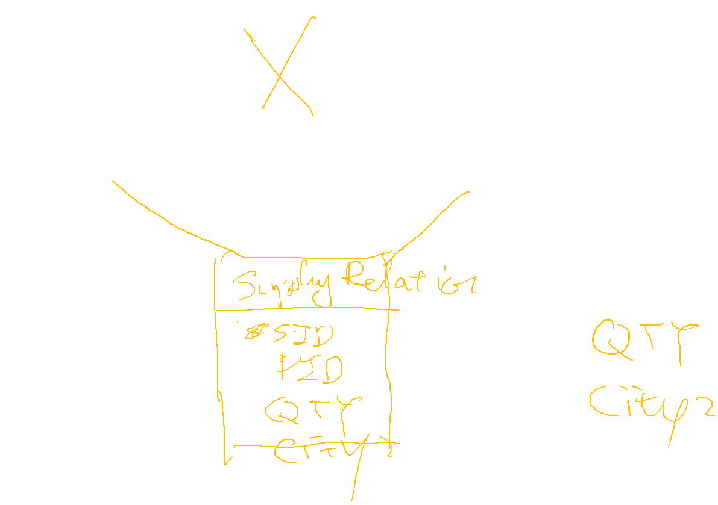
‹#›

Slide 58
你現在是一個系統分析師,你的任務是分析ㄧ個校務行政系統.請畫出此系統的UML 圖, 以下是概略的需求分析
一個老師可以敎許多門課,
每一個學生可以自行選修課來修,
目前的開授的科目有英文,數學,物理,化學,國文.
每一個開課的科目包含授課時數,授課教室,授課時段,授課年級與班級以及授課老師等資訊.
學生的學籍包含身分證號碼,學號,年級,姓名,住址
每個學生都會被編到一個班級上課,由一位老師擔任導師
‹#›

Slide 59
You are a system analyst and you are responsible for analyze an e-school system Please draw UML diagram for the following requirement
A teacher can teach many courses
A student can enroll in several courses
The course subject include Chinese, English, Math, Chemistry
A course has hours, classroom, time slots, grades, class, teacher
A student has ID, name, grade, address
Each student will be assigned to a class. There is one teacher will be assigned to the class as an advisor.
‹#›

Slide 60
Discussion Comment
Do you need to make subject into a table?
If for a hundred year, your subject name change little, a table can be skipped. A string field can be used in the course table. But somehow your program need to maintain a list of these subjects (strings) as well.
However, if you have additional attributes needed to be added to a subject. Such as course description, course textbook, etc. Making it into a table is a better solution.
‹#›

Slide 61
What if you don’t normalize?
You may write
Class student {
int sid ;
vector<course*> my_courses;
}
Class course {
int cid ;
vector<students*> students ;
}
What’s wrong?
如果上級長官有要求，要求你紀錄每個學生修課時的到課時數 (註:任何新的屬性與兩者都相關)
‹#›

